Slide 1

Frito Lay Attrition
Kyle Davisson

Slide 2
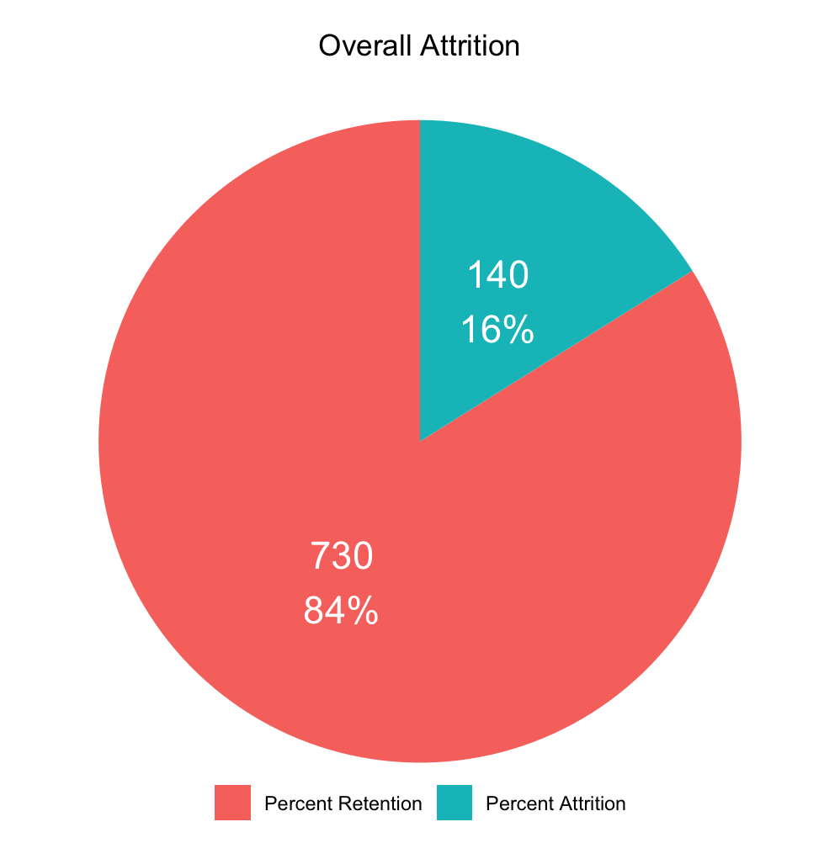
Attrition Summary
Cost of Attrition:
50% - 400% yearly salary
Average yearly salary $57,177
Cost of Retention:
$200 incentive
Figure out what factors predict attrition
Apply them to machine learning models

Slide 3
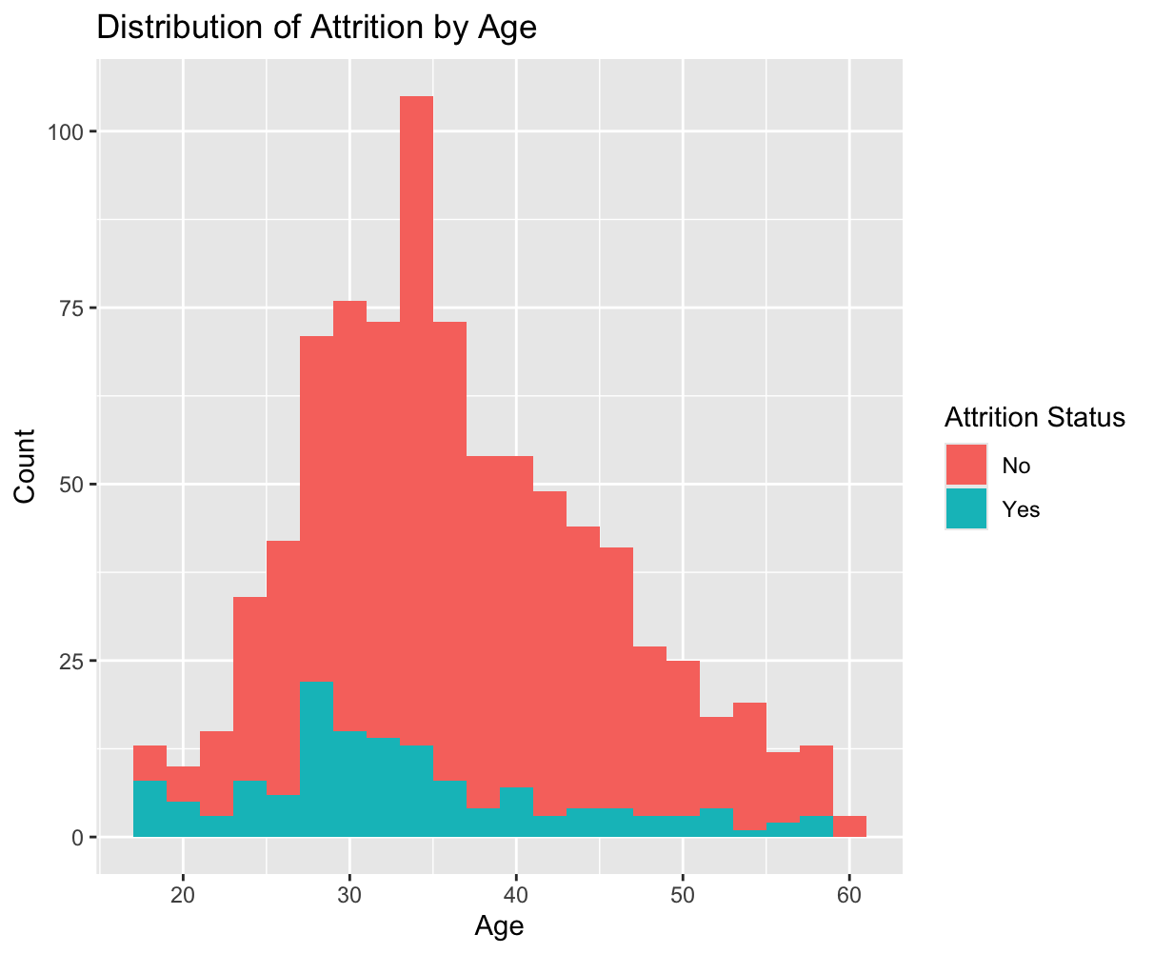
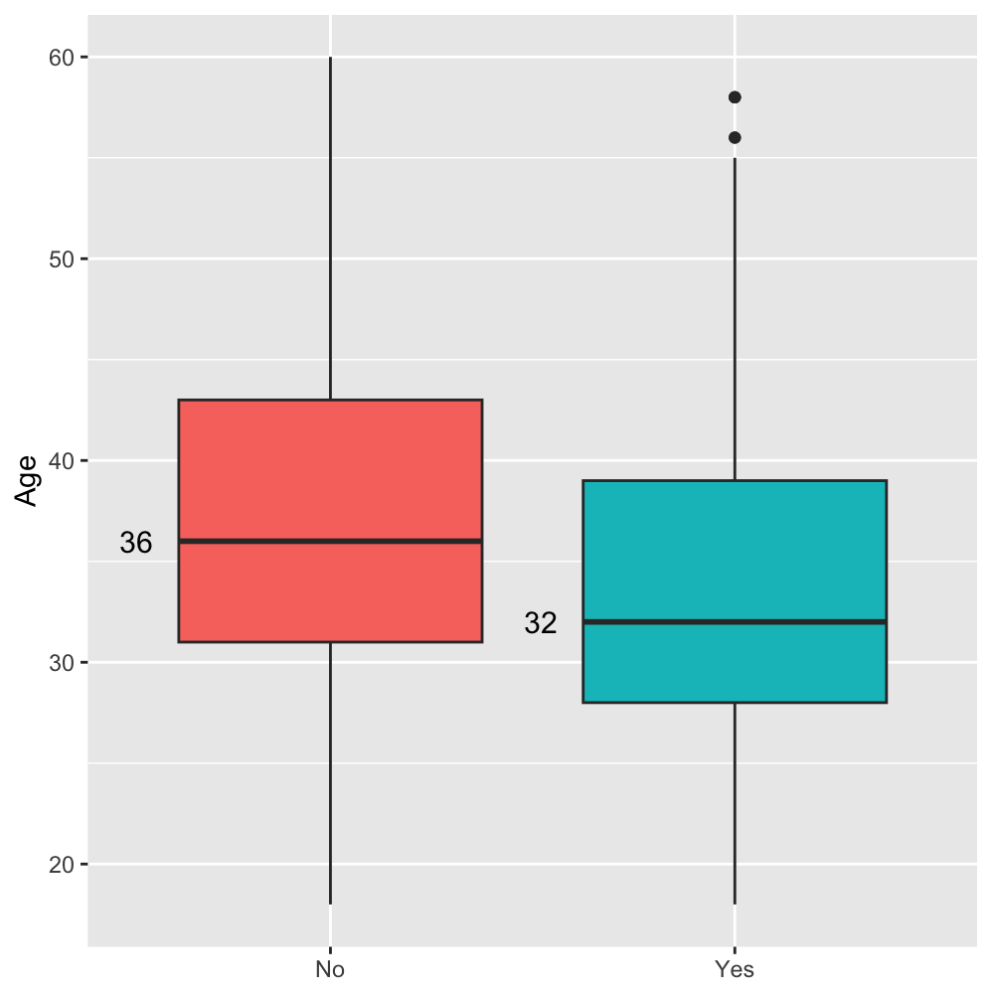
Age
Those who leave are younger on average

Slide 4
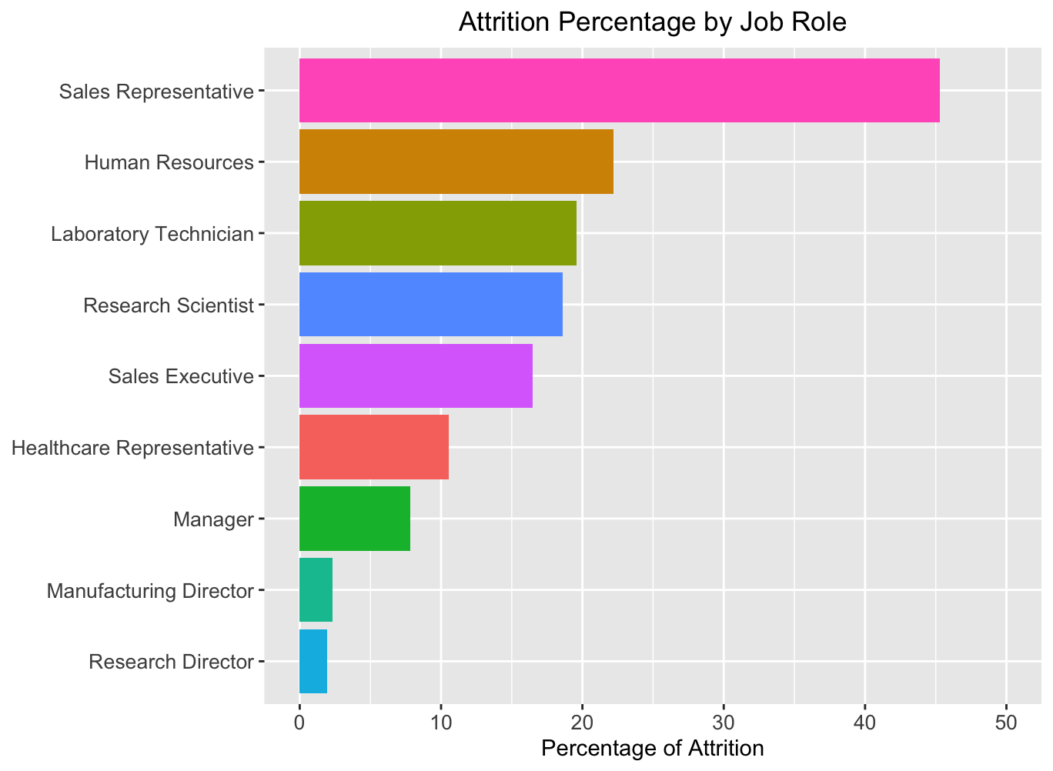
Which Jobs are Playing a Role in Attrition?
Sales Representatives have the highest rate of attrition
Followed by Human Resources, Laboratory Technician, and Research Scientist

Slide 5
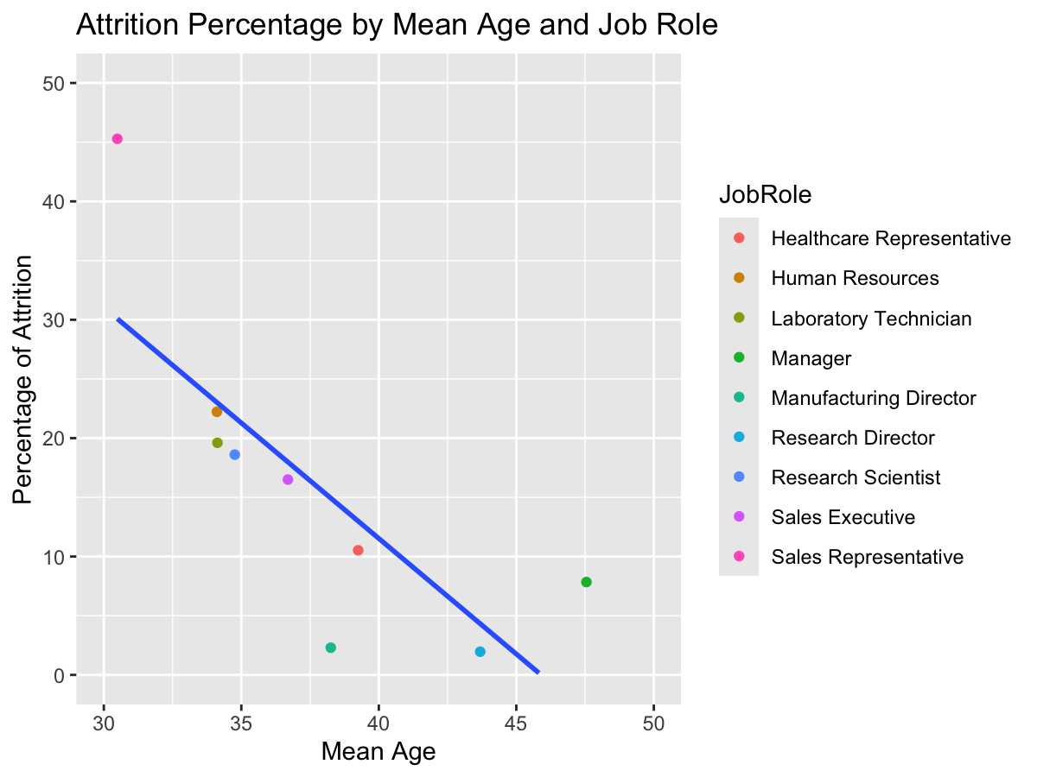
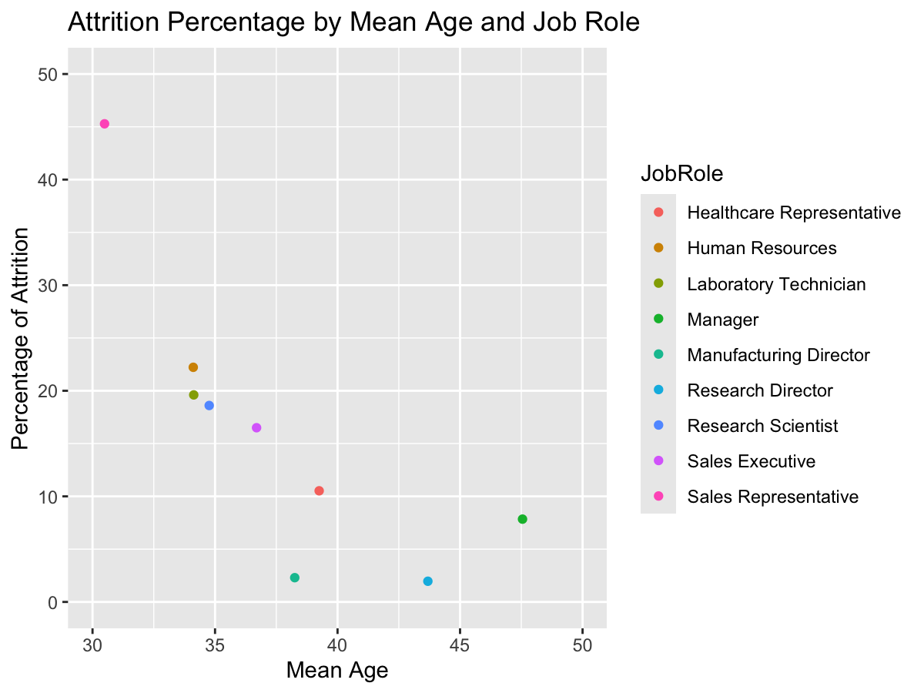
Age and Role
There is strong evidence of a relationship between Age and Attrition
High attrition in Sales seems to be related to low average age
Attrition may be more related to age than Job Role

Slide 6
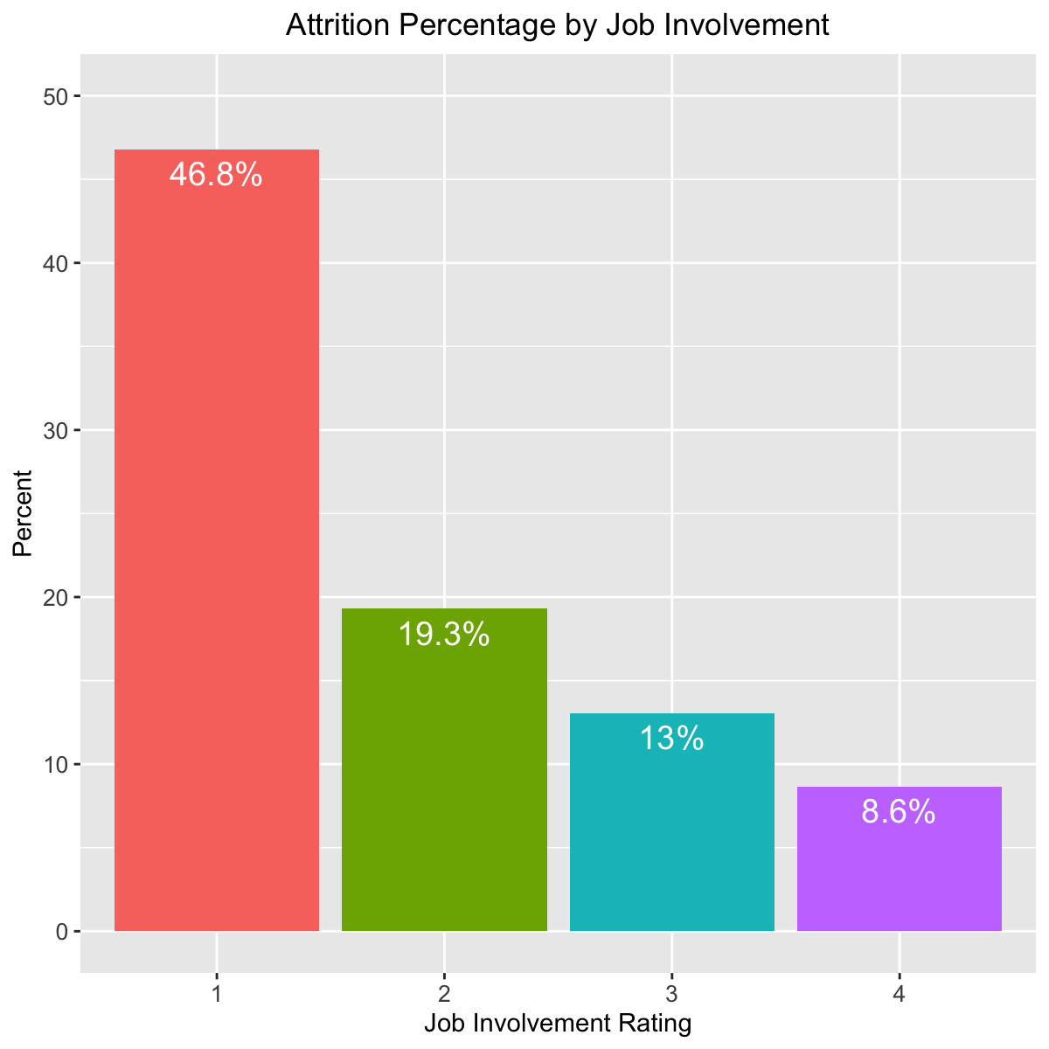
Job Involvement
Rating 1 has the highest attrition rate
More than double that of Level 2
Is not related to age

Slide 7
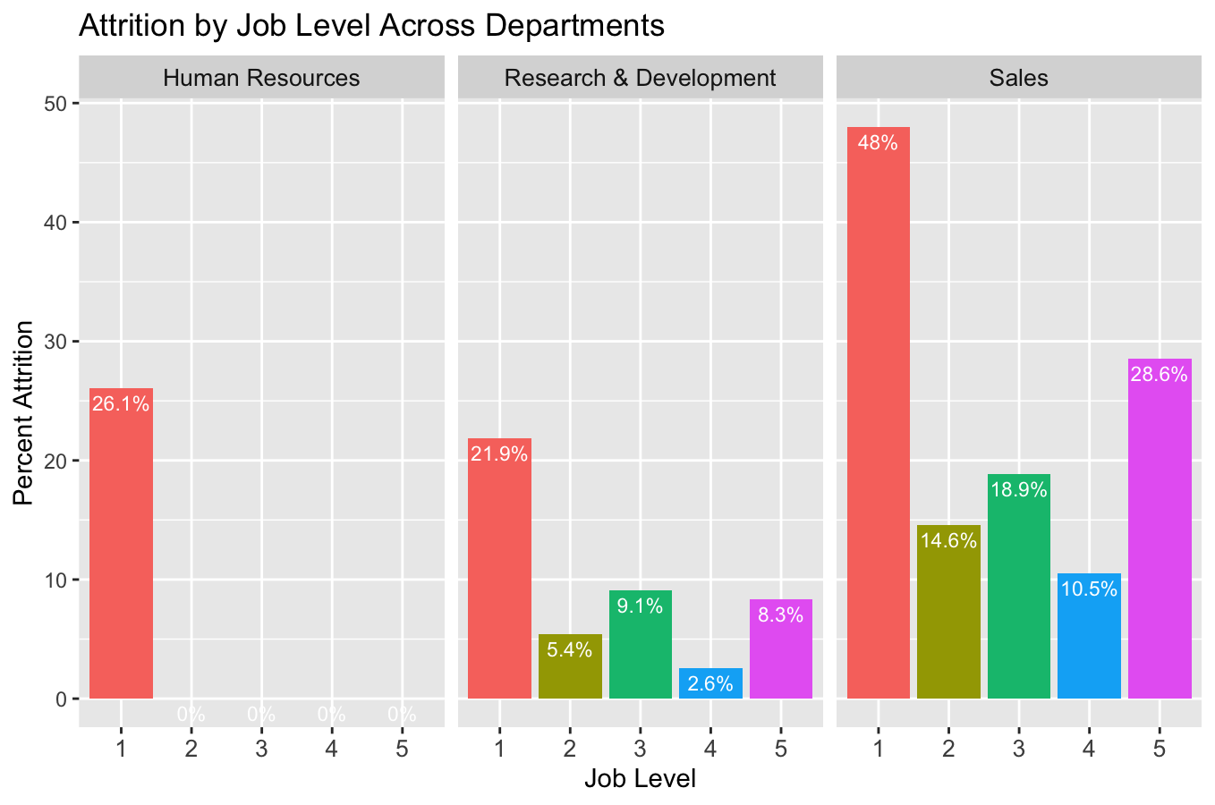
Job Level
Job Level 1 has highest attrition
Most likely associated with age

Slide 8
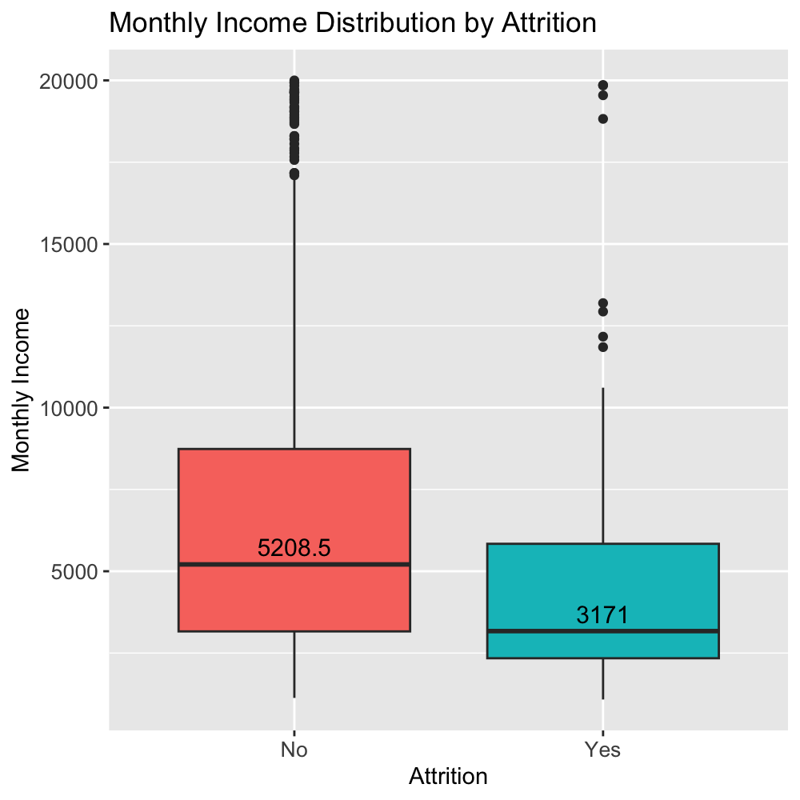
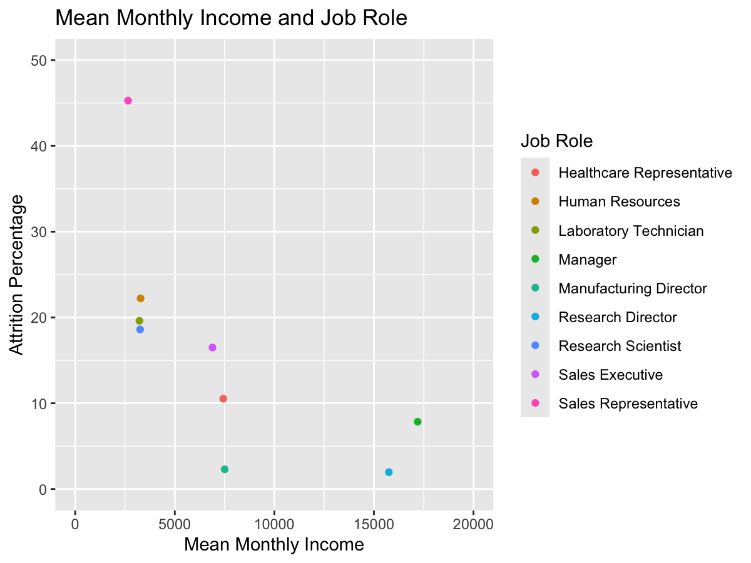
Monthly Income
Despite overlap, strong evidence
Mean for Attritted: $4765
Mean for Non-Attritted: $6702

Slide 9
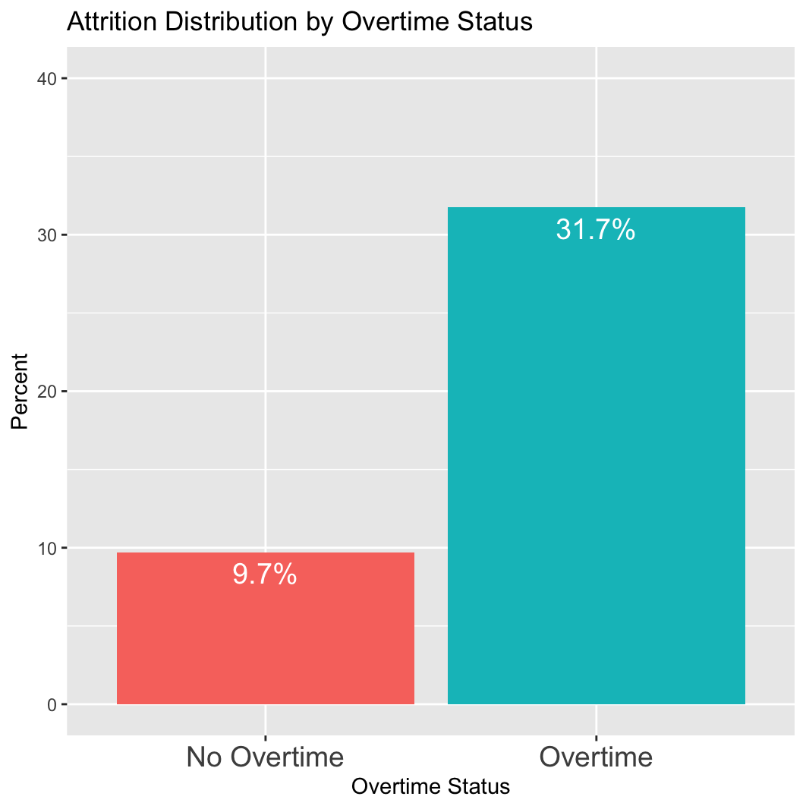
Overtime
Overtime employees leave at a much higher rate

Slide 10
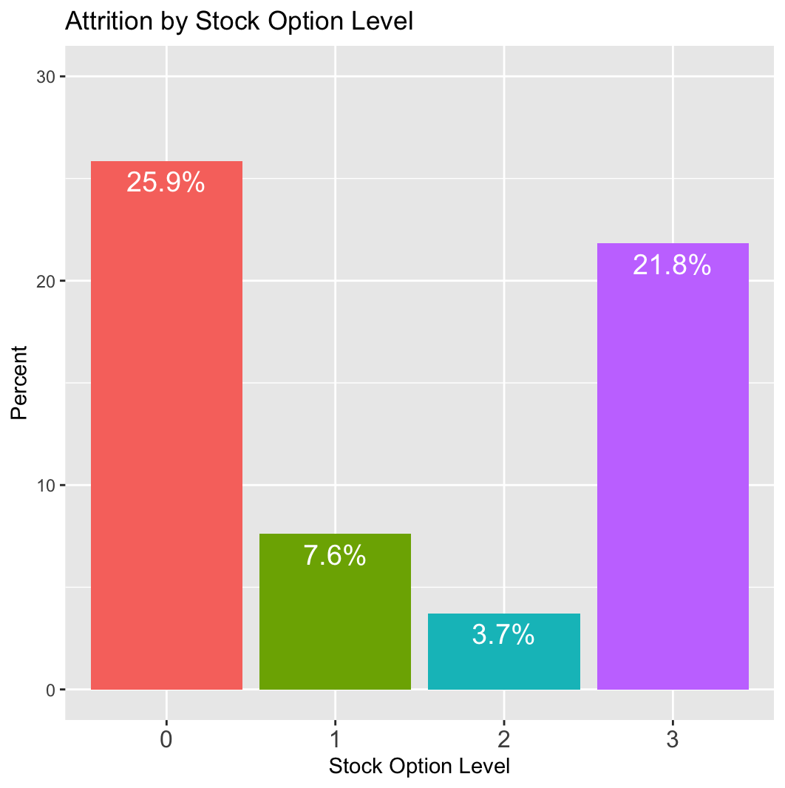
Stock Options
Strong evidence
Level 0
Level 3
Large difference for 1 & 2

Slide 11
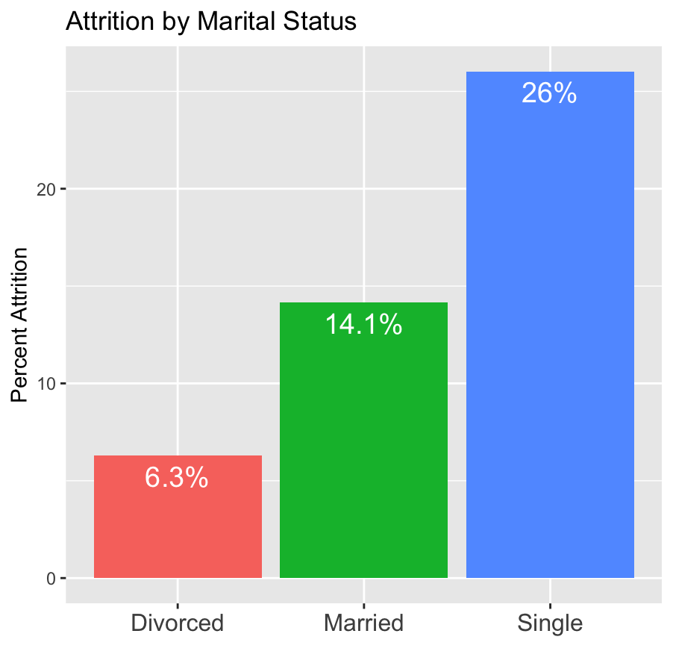
Marital Status Effects
About a quarter of single employees leave
Divorced employees are least likely
Slight difference in ages
Average age of Married/Divorced is 37.5
Average age of Single is 35.2

Slide 12
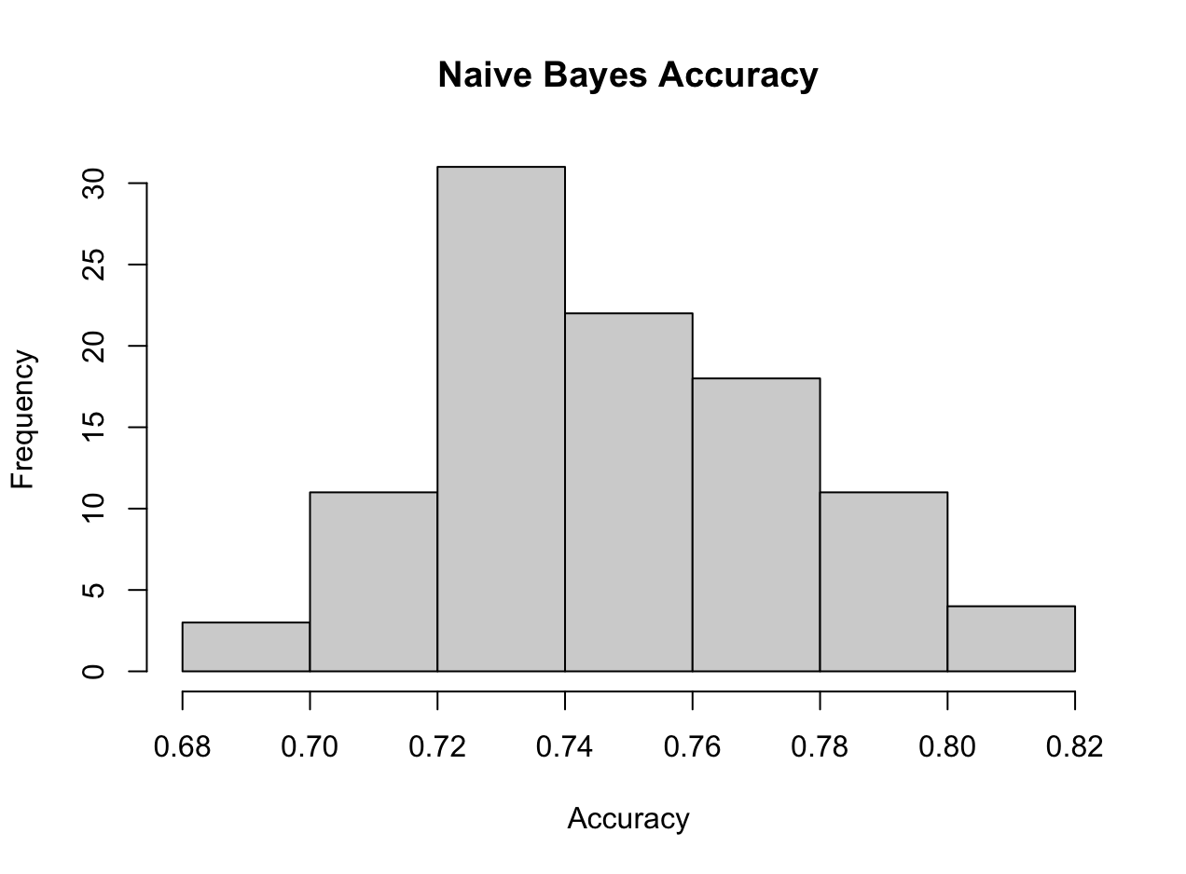
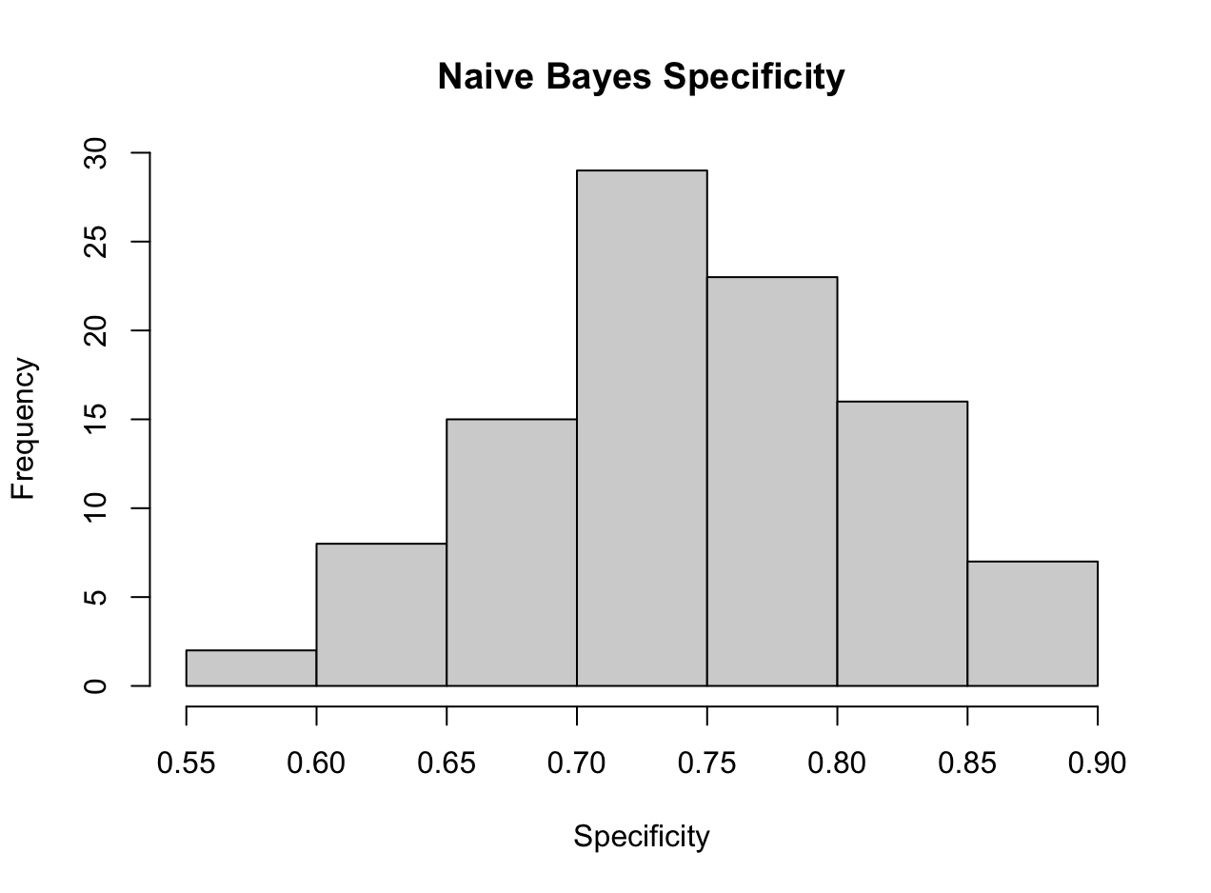
Naïve Bayes
Used a variety of predictors
Job Involvement
Job Level
Marital Status
Monthly Income
Overtime
Stock Option Level
Distance From Home
Train/Test split: 70-30
100 iterations
Threshold of 0.2
Results
Mean Accuracy: 0.75
Mean Sensitivity: 0.75
Mean Specificity: 0.75

Slide 13
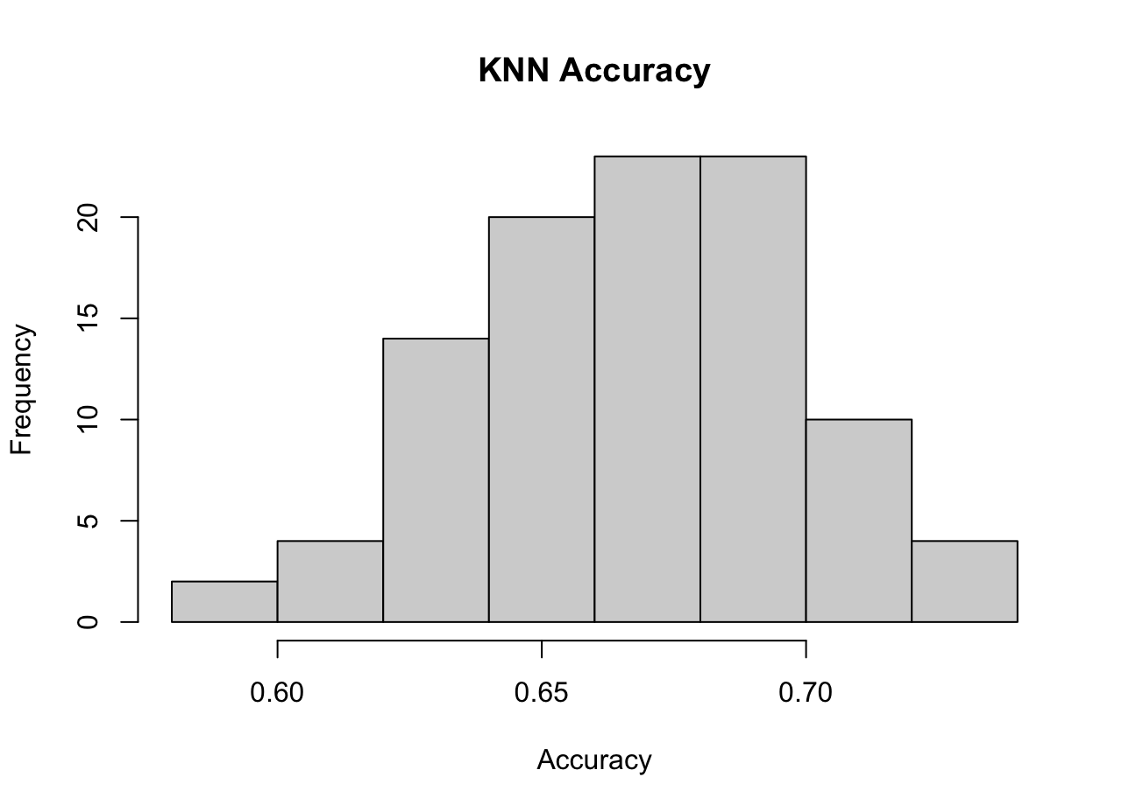
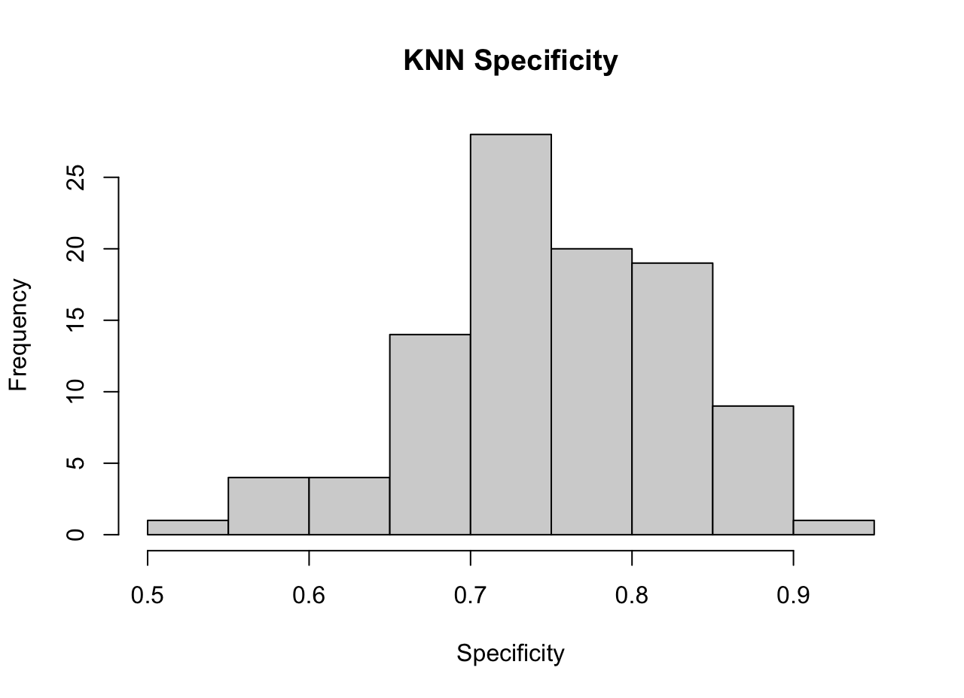
KNN
Used the same features
Job Involvement
Job Level
Marital Status
Monthly Income
Overtime
Stock Option Level
Distance From Home
Train/Test split: 70-30
100 iterations
Threshold of 0.2
Results
Mean Accuracy: 0.66
Mean Sensitivity: 0.65
Mean Specificity: 0.75

Slide 14

Additional questions, please reach out to kdavisson@smu.edu

